Slide 1
205SE Programming for Engineers
Tutorial 10
Data Structures – std::vector and other Containers

Slide 2
Recap on Last Week
Arrays
Declaring Arrays
Initialising Elements
Using Arrays
Using for loops with arrays to step through elements
Deitel exercises fig 7.03 to fig 7.12

Slide 3

Today’s Objectives
Explore arrays and sorting algorithms
Deitel exercises fig 7.13 to fig 7.26
Data structures
std::vector
others

Slide 4

Sorting Algorithms
Insertion sort, Selection sort, Bubble sort, Shell sort, Merge sort, Heap sort, Quick sort, Bucket sort, Radix sort
Demonstration of Some Sorting Algorithms:
http://www.sorting-algorithms.com/
http://cs.smith.edu/~thiebaut/java/sort/demo.html
What is “Big O notation”
Mathematical expression of the computational complexity vs. the input size

Slide 5

Activity 1 – Library data structures
Explore the C++ containers library reference:
http://en.cppreference.com/w/cpp/container
std::vector is like a dynamic array
Can change in size by itself to accommodate newly added data
Check out the std::vector in the library reference :
http://en.cppreference.com/w/cpp/container/vector

Slide 6
Class Question
How can we allow the user to change the size of the multiplication square while the program is running
i.e. change the size of the array during run-time?

Slide 7
std::vector
How can we allow the user to change the size of the multiplication square while the program is running
Remember that once we declare an array size 10 we cannot change it, array sizes are fixed/const!
Try using a library data structure instead:
std::vector<int> myVector;
Hint: This is declaring a 1D vector of integers, start with learning how to use that first.
Then think about the multiplication square after.

Slide 8
Activity 2 – std::vector
Vectors provide a lot more functionality than a primitive array.
Using a std::vector, write a program which asks the user what size vector they would they like to see and then using the .push_back() method of vector, gradually put numbers into the vector in a looping structure.
Each time a new number is put into the vector, output the current size() and the capacity() of the vector to the screen.
Finally, after populating the entire vector, output all of the elements contained in the vector in a single line.

Slide 9
std::vector methods you should be comfortable with using:
myVector.at() and myVector[]
myVector.empty()
myVector.size()
myVector.capacity()
myVector.clear()
myVector.insert()
myVector.erase()
myVector.push_back()
myVector.pop_back()
myVector.resize()
If you have not seen one of these methods being used yet, or are not sure what they do then try them in your program now.

Slide 10
Activity 3 – 2D std::vector
Create a runtime resizable multiplication square with a 2D vector (a vector of vectors)
A 2D vector can be declared by:
vector<vector<int>> multiSquare;

Slide 11
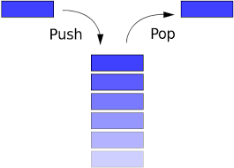
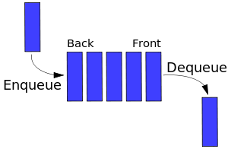
Activity 4 – Other types of data structures (containers) to experiment with:
stack is like a stack of plates
LIFO data structure
Push data on top, Pop data off top
queue is like waiting in line at a supermarket
FIFO data structure
Buffer for data
Enqueue data at the back, Dequeue data at the front
deque is like a double ended queue

Slide 12
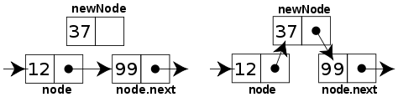
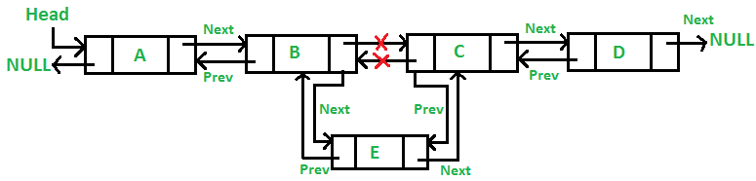
Activity 5 – More types of data structure:
forward_list (C++11)
forward_list is a linked list
Built with pointers (we cover them next tutorial)
Pointer points to the next piece of data in the chain
Very efficient for inserting new data (think about how this compares with inserting data into an array/vector from a memory allocation standpoint)
list is a doubly linked list
Pointers in both directions – can traverse in both directions

Slide 13
Activity 6 – Even more types of data structure to try
map is like a lookup table or dictionary
stores <key, value> pairs
lookup a key, get back the value (e.g. an object)
fast lookup of keys and return of values
Key (often a simple type) | Value (often a complex Object)
“MY CAR” | the car object itself
“JA62 UAR” | the car object itself
“R3D CAR” | the car object itself
“UK PL8TE” | the car object itself
“JB 007” | the car object itself

Slide 14

CodinGame Activity 7
Break into mini competition groups (desk of 6?)
With everyone on your desk/group starting at the same time, (wait/help the rest of the group to complete the previous task first), see who can solve the following CodinGame puzzle first:
This one requires the use of 2D data structures. Arrays or vectors will work, but try a 2D vector for practice:
The Last Crusade:
https://www.codingame.com/training/medium/the-last-crusade-episode-1

Slide 15
Deitel Figures 7.13 to 7.20
7.13 – Static arrays
7.14 – Passing arrays to functions by reference (points to original array) and by value (local copy)
7.15 – Passing using ‘const’ keyword
7.19 – Linear search through an array
7.20 – Sorting arrays via the insertion sort algorithm
7.22 – 2D arrays
7.26 – C++ std::vector data structure

